Slide 1

Machine Learning Course Overview
Data Analytics Department
Bridgerland Technical College

Slide 2
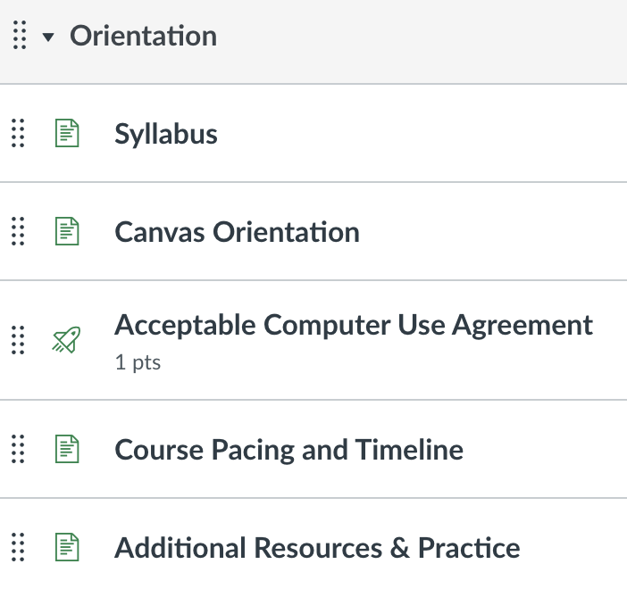
Orientation

Slide 3
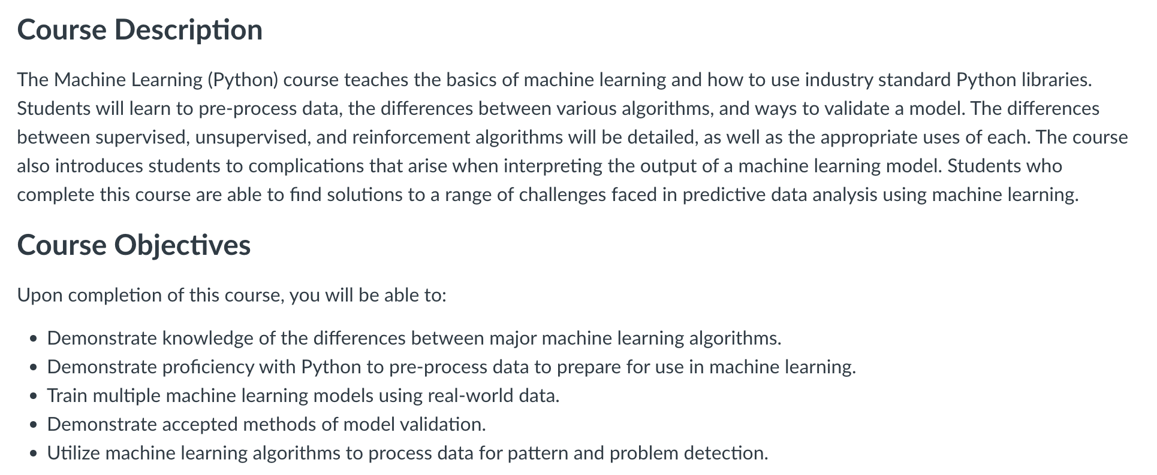

Slide 4
Orientation

Slide 5
Orientation

Slide 6
Orientation

Slide 7


Slide 8
Orientation

Slide 9
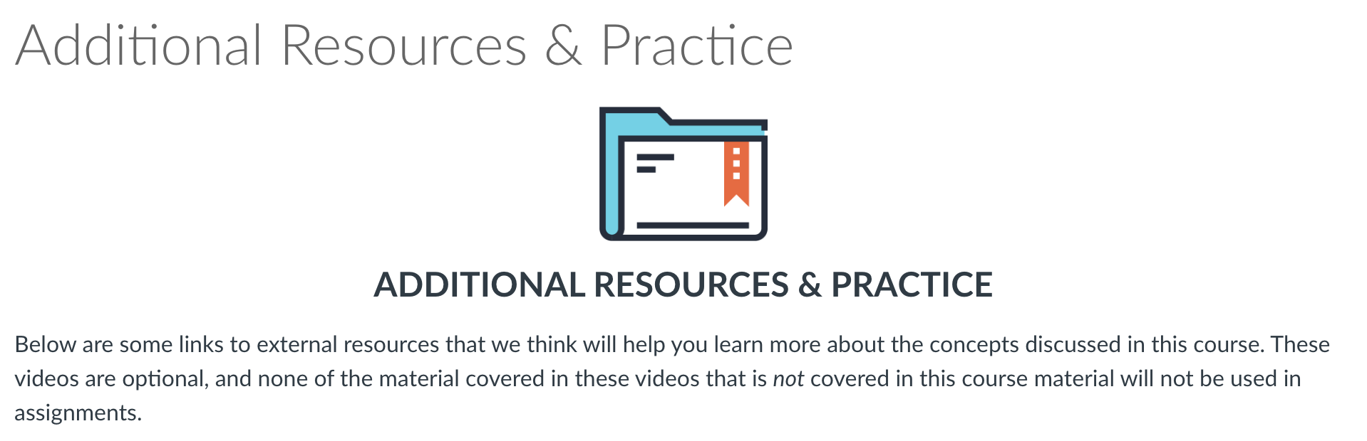

Slide 10
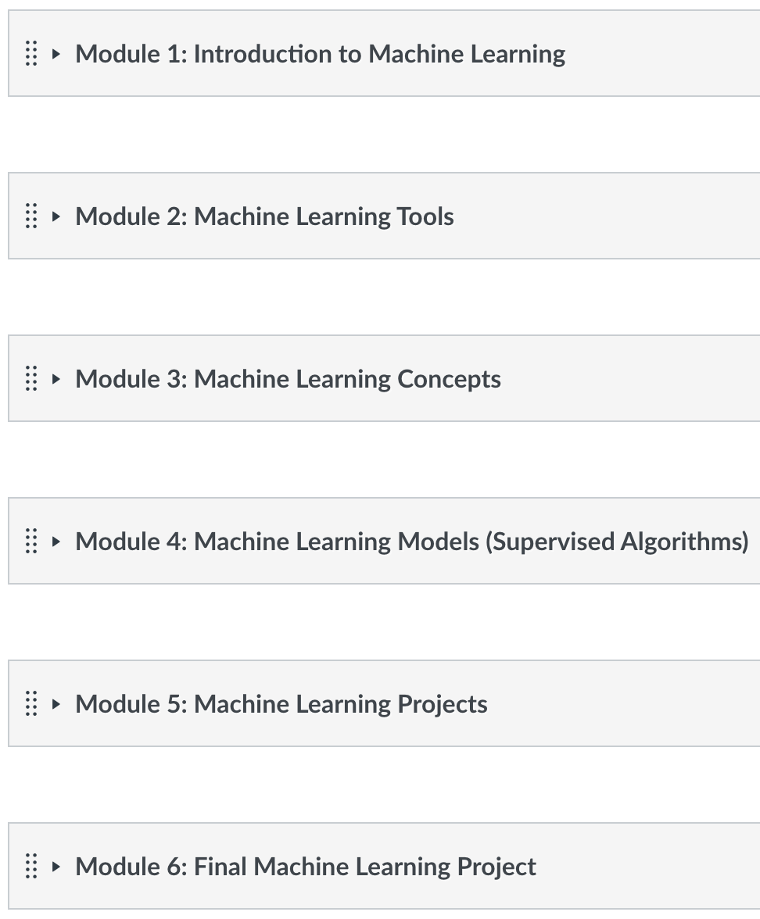
modules
6 modules
Each module contains
New material
Extra Practice
Feedback

Slide 11
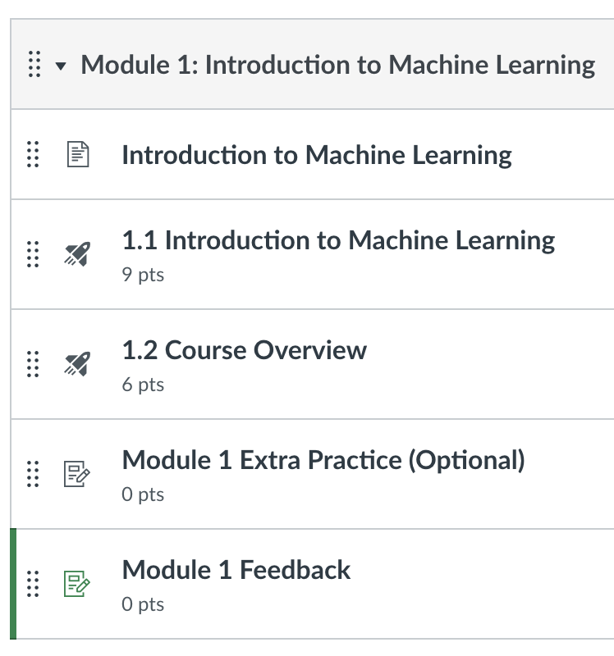
Module 1

Slide 12
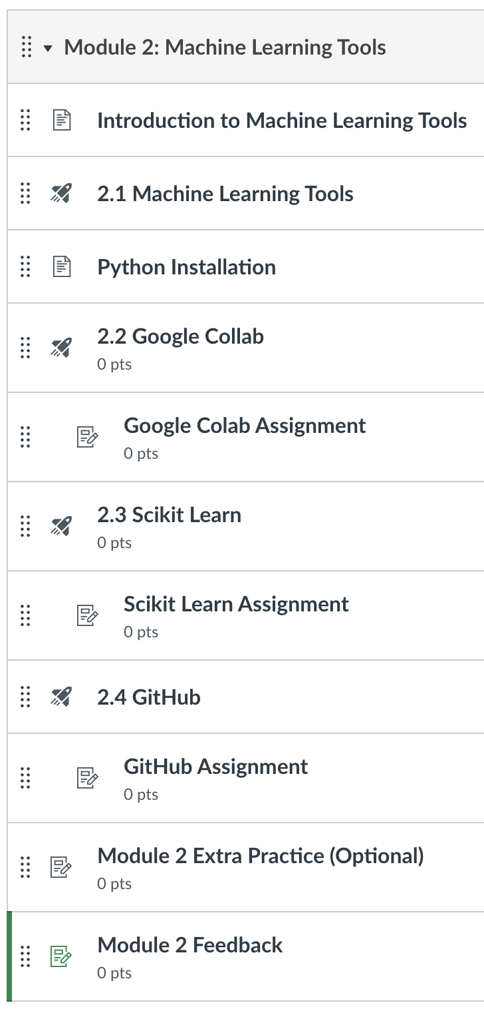
Module 2

Slide 13
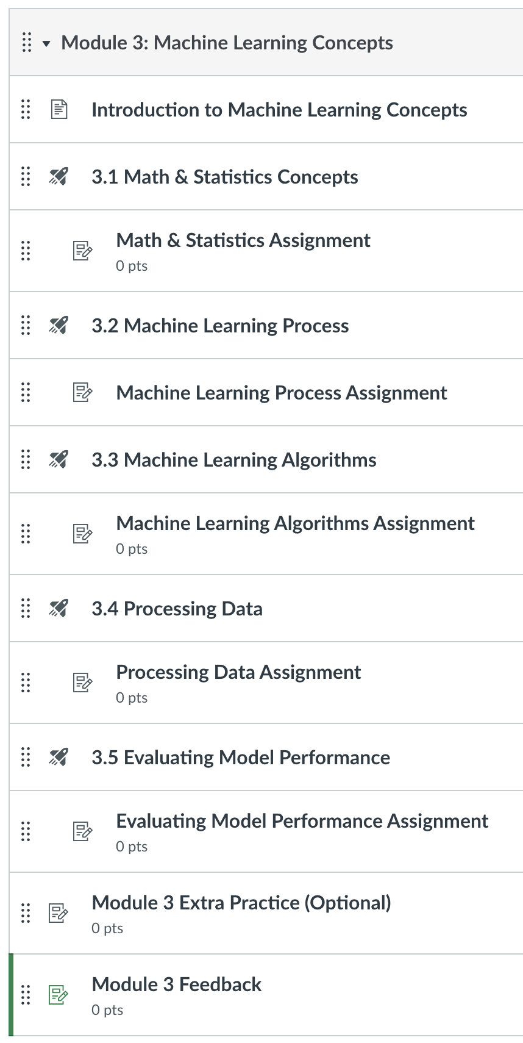
Module 3

Slide 14
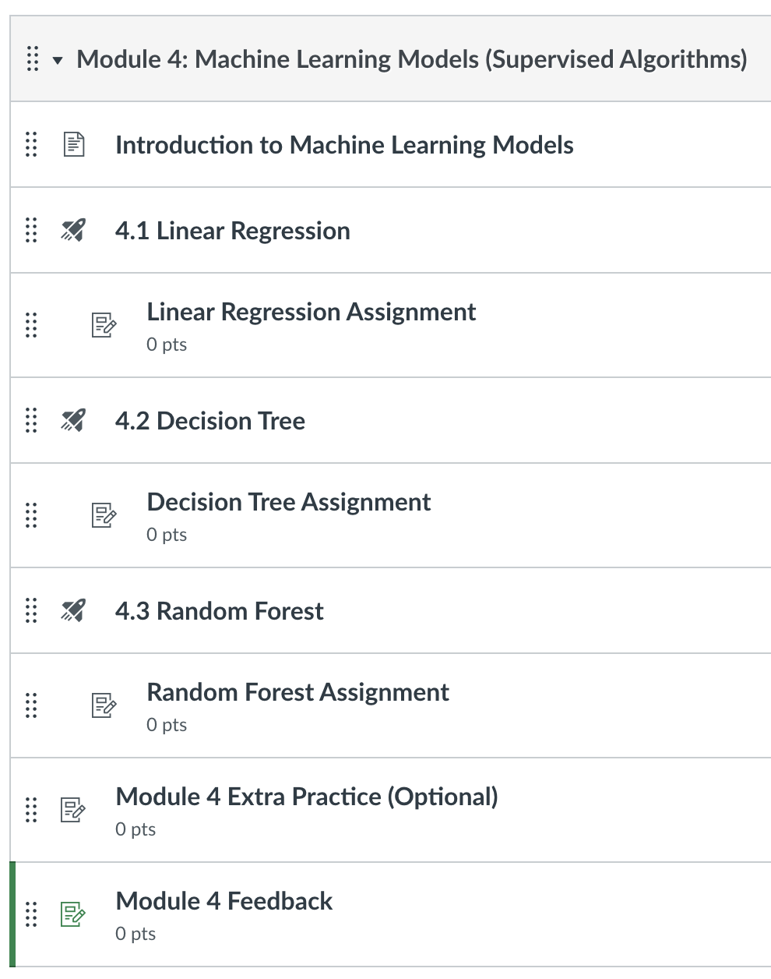
Module 4

Slide 15
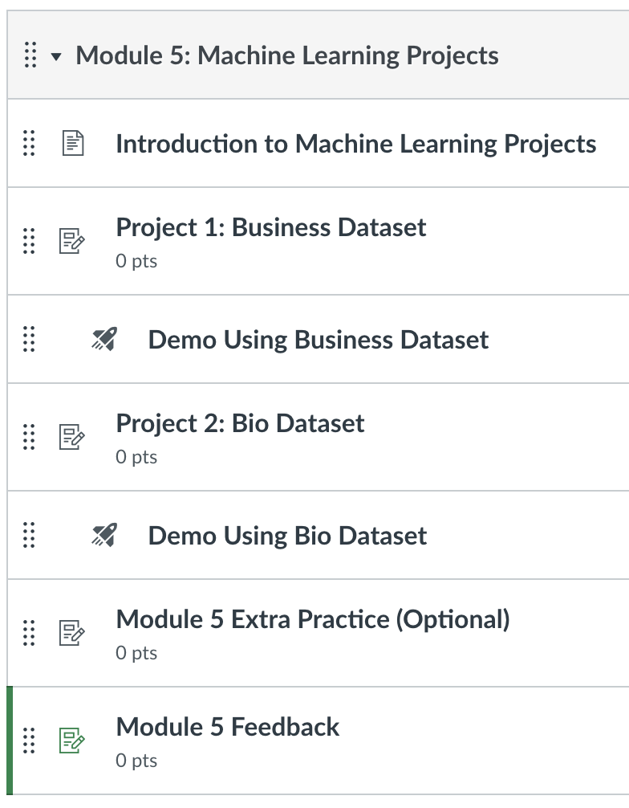
Module 5

Slide 16
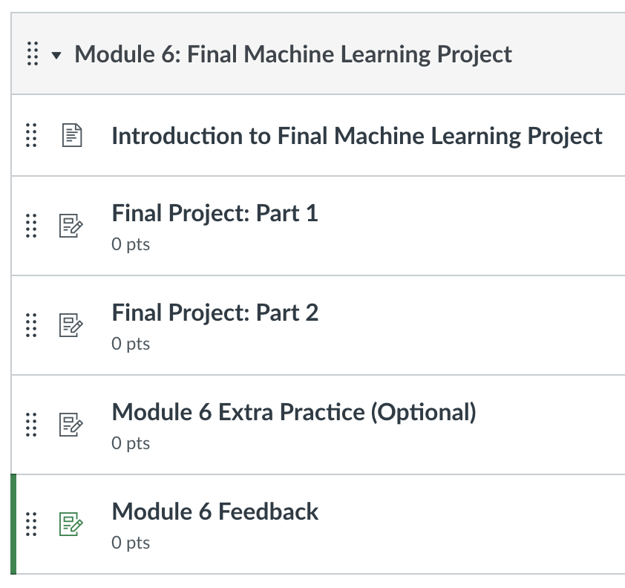
Module 6

Slide 17
Additional resources

Slide 18
questions
Which Machine Learning Models does this course cover?
How many projects does this course have?

